Slide 1

DIVINE GRACE COLLEGE OF ARTS, SCIENCE AND TECHNOLOGY
(DGCAST) — GAROUA | GEOGRAPHY DEPARTMENT
UPPER SIXTH ARTS — PRACTICAL GEOGRAPHY — QUANTITATIVE TECHNIQUES 2
Data Collection: Sources and Techniques
Mr KAMDEM EMMANUEL
Geography Teacher — PLEG
Academic Year 2026 / 2027
Notes:
Good morning, class. Today we study Quantitative Techniques 2: Data Collection: Sources and Techniques.

Slide 2
GEOGRAPHY — UPPER SIXTH ARTS
CLASS INFO
Class, Chapter & Duration
Class | Upper Sixth Arts
Chapter | Module 8: Understanding and carrying out statistical techniques, topographic map analysis, fieldwork and project based learning
Duration | 2 periods (2 × 50 minutes)
2026 / 2027
DGCAST GAROUA — GEOGRAPHY DEPARTMENT
Mr KAMDEM E. | 2

Slide 3
GEOGRAPHY — UPPER SIXTH ARTS
IDENTIFICATION
Lesson Identification
Topic | Quantitative Techniques in Geography
Sub-topic | Statistical Techniques
Lesson | Quantitative Techniques 2: Data Collection: Sources and Techniques
Notions / Concepts | Primary data, secondary data, sampling, random, systematic, stratified, questionnaire, interview, focus group.
Syllabus focus | Sources of geographical data; basic sampling procedures; observation, counting, photographs and video; measurements; questionnaires, interviews and focus groups.
Competence | Learners are able to choose data sources, select samples and design simple questionnaires.
2026 / 2027
DGCAST GAROUA — GEOGRAPHY DEPARTMENT
Mr KAMDEM E. | 3

Slide 4
GEOGRAPHY — UPPER SIXTH ARTS
OBJECTIVES
Learning Objectives
By the end of the lesson, the learner should be able to:
Distinguish primary and secondary data.
Describe random, systematic and stratified sampling.
Design a simple questionnaire and plan an interview.
2026 / 2027
DGCAST GAROUA — GEOGRAPHY DEPARTMENT
Mr KAMDEM E. | 4

Slide 5
GEOGRAPHY — UPPER SIXTH ARTS
RECALL
Recall
Geographers collect information in the field.
A census counts people.
2026 / 2027
DGCAST GAROUA — GEOGRAPHY DEPARTMENT
Mr KAMDEM E. | 5

Slide 6
GEOGRAPHY — UPPER SIXTH ARTS
REAL-LIFE SITUATION
Real-Life Situation
The class wants to know why people in the town buy food at the market rather than in shops. They cannot ask everybody, so they must choose some people and prepare questions.
2026 / 2027
DGCAST GAROUA — GEOGRAPHY DEPARTMENT
Mr KAMDEM E. | 6
Notes:
Read the situation slowly, twice.

Slide 7
GEOGRAPHY — UPPER SIXTH ARTS
REAL-LIFE SITUATION
Situation — Question 1
What is the problem in the situation?
2026 / 2027
DGCAST GAROUA — GEOGRAPHY DEPARTMENT
Mr KAMDEM E. | 7

Slide 8
GEOGRAPHY — UPPER SIXTH ARTS
REAL-LIFE SITUATION
Answer
The class must collect data from part of the population.
2026 / 2027
DGCAST GAROUA — GEOGRAPHY DEPARTMENT
Mr KAMDEM E. | 8

Slide 9
GEOGRAPHY — UPPER SIXTH ARTS
REAL-LIFE SITUATION
Situation — Question 2
What is choosing some people called?
2026 / 2027
DGCAST GAROUA — GEOGRAPHY DEPARTMENT
Mr KAMDEM E. | 9

Slide 10
GEOGRAPHY — UPPER SIXTH ARTS
REAL-LIFE SITUATION
Answer
Sampling.
2026 / 2027
DGCAST GAROUA — GEOGRAPHY DEPARTMENT
Mr KAMDEM E. | 10

Slide 11
GEOGRAPHY — UPPER SIXTH ARTS
REAL-LIFE SITUATION
Situation — Question 3
Which tool contains the questions?
2026 / 2027
DGCAST GAROUA — GEOGRAPHY DEPARTMENT
Mr KAMDEM E. | 11

Slide 12
GEOGRAPHY — UPPER SIXTH ARTS
REAL-LIFE SITUATION
Possible Answer
A questionnaire.
2026 / 2027
DGCAST GAROUA — GEOGRAPHY DEPARTMENT
Mr KAMDEM E. | 12

Slide 13
GEOGRAPHY — UPPER SIXTH ARTS
JUSTIFICATION
Justification of the Lesson
This lesson helps us to collect reliable data for geographical studies.
2026 / 2027
DGCAST GAROUA — GEOGRAPHY DEPARTMENT
Mr KAMDEM E. | 13

Slide 14
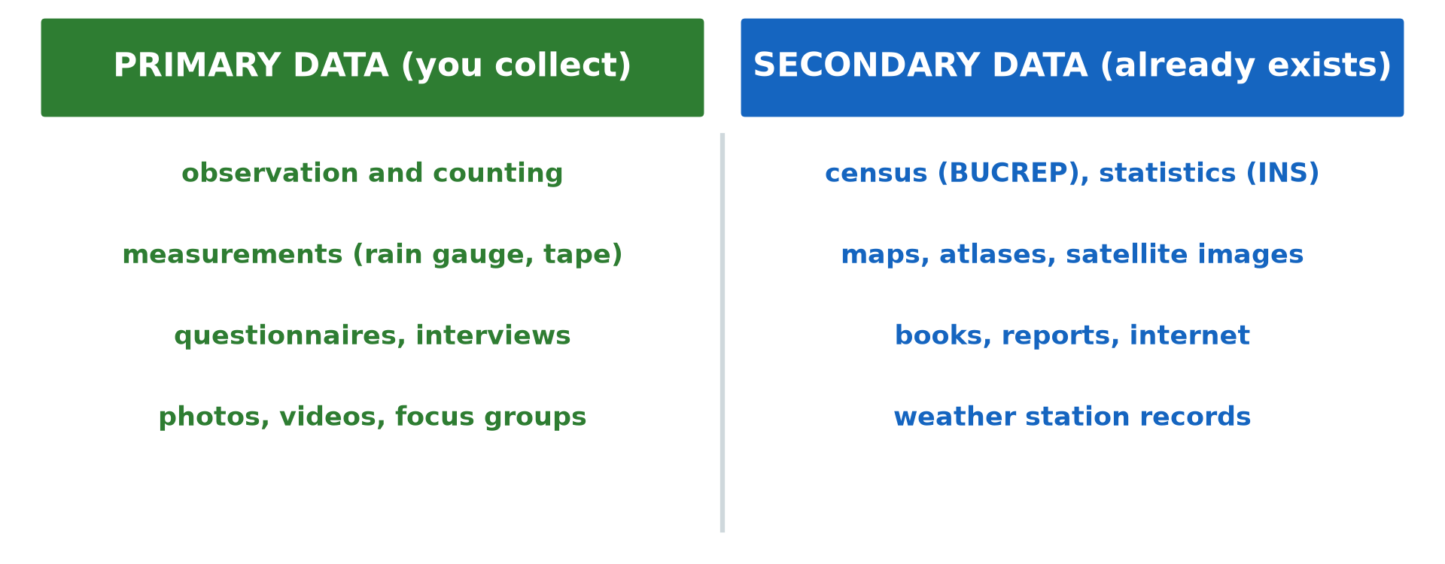
GEOGRAPHY — UPPER SIXTH ARTS
I. SOURCES
Activity 1
Primary and secondary data.
2026 / 2027
DGCAST GAROUA — GEOGRAPHY DEPARTMENT
Mr KAMDEM E. | 14
Notes:
Without the projector: list sources.

Slide 15
GEOGRAPHY — UPPER SIXTH ARTS
I. SOURCES
Activity 1: Question
Distinguish primary and secondary data with one example each.
2026 / 2027
DGCAST GAROUA — GEOGRAPHY DEPARTMENT
Mr KAMDEM E. | 15

Slide 16
GEOGRAPHY — UPPER SIXTH ARTS
I. SOURCES
Answer
Primary: collected yourself (a traffic count). Secondary: already exists (census).
2026 / 2027
DGCAST GAROUA — GEOGRAPHY DEPARTMENT
Mr KAMDEM E. | 16

Slide 17
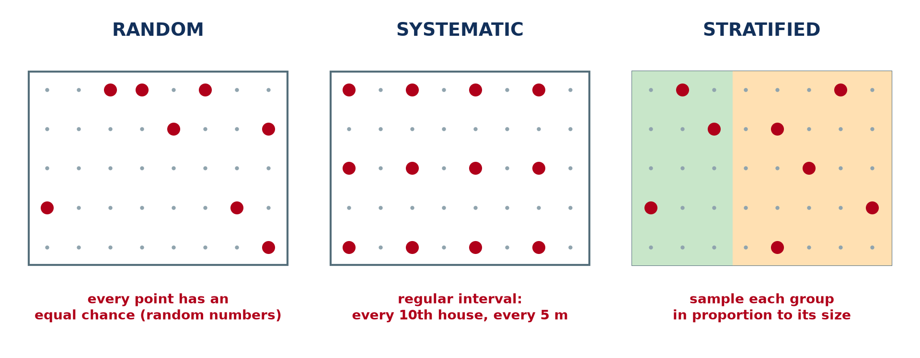
GEOGRAPHY — UPPER SIXTH ARTS
II. SAMPLING
Activity 2
Sampling methods.
2026 / 2027
DGCAST GAROUA — GEOGRAPHY DEPARTMENT
Mr KAMDEM E. | 17
Notes:
Without the projector: explain sampling.

Slide 18
GEOGRAPHY — UPPER SIXTH ARTS
II. SAMPLING
Activity 2: Question
Why do geographers use samples?
2026 / 2027
DGCAST GAROUA — GEOGRAPHY DEPARTMENT
Mr KAMDEM E. | 18

Slide 19
GEOGRAPHY — UPPER SIXTH ARTS
II. SAMPLING
Answer
It saves time and money when the whole population cannot be studied.
2026 / 2027
DGCAST GAROUA — GEOGRAPHY DEPARTMENT
Mr KAMDEM E. | 19

Slide 20
GEOGRAPHY — UPPER SIXTH ARTS
II. METHODS
Activity 3
Random, systematic and stratified.
2026 / 2027
DGCAST GAROUA — GEOGRAPHY DEPARTMENT
Mr KAMDEM E. | 20
Notes:
Without the projector: plan a sample.

Slide 21
GEOGRAPHY — UPPER SIXTH ARTS
II. METHODS
Activity 3: Question
How would you take a systematic sample of 20 houses on a street of 200?
2026 / 2027
DGCAST GAROUA — GEOGRAPHY DEPARTMENT
Mr KAMDEM E. | 21

Slide 22
GEOGRAPHY — UPPER SIXTH ARTS
II. METHODS
Answer
Choose every 10th house.
2026 / 2027
DGCAST GAROUA — GEOGRAPHY DEPARTMENT
Mr KAMDEM E. | 22

Slide 23
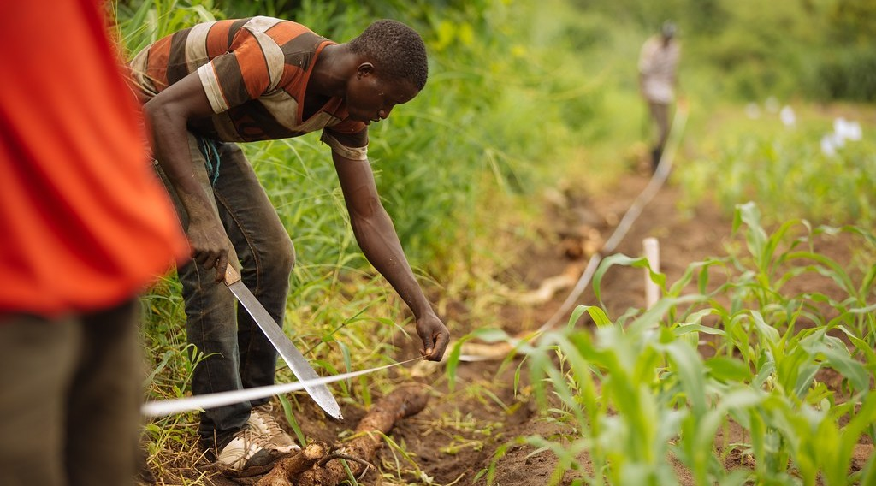
GEOGRAPHY — UPPER SIXTH ARTS
III. OBSERVATION AND MEASUREMENT
Activity 4
Measuring in the field.
2026 / 2027
DGCAST GAROUA — GEOGRAPHY DEPARTMENT
Mr KAMDEM E. | 23
Notes:
Without the projector: list tools.

Slide 24
GEOGRAPHY — UPPER SIXTH ARTS
III. OBSERVATION AND MEASUREMENT
Activity 4: Question
Give two tools for field measurement.
2026 / 2027
DGCAST GAROUA — GEOGRAPHY DEPARTMENT
Mr KAMDEM E. | 24

Slide 25
GEOGRAPHY — UPPER SIXTH ARTS
III. OBSERVATION AND MEASUREMENT
Answer
Measuring tape and rain gauge (also compass, clinometer, GPS).
2026 / 2027
DGCAST GAROUA — GEOGRAPHY DEPARTMENT
Mr KAMDEM E. | 25

Slide 26
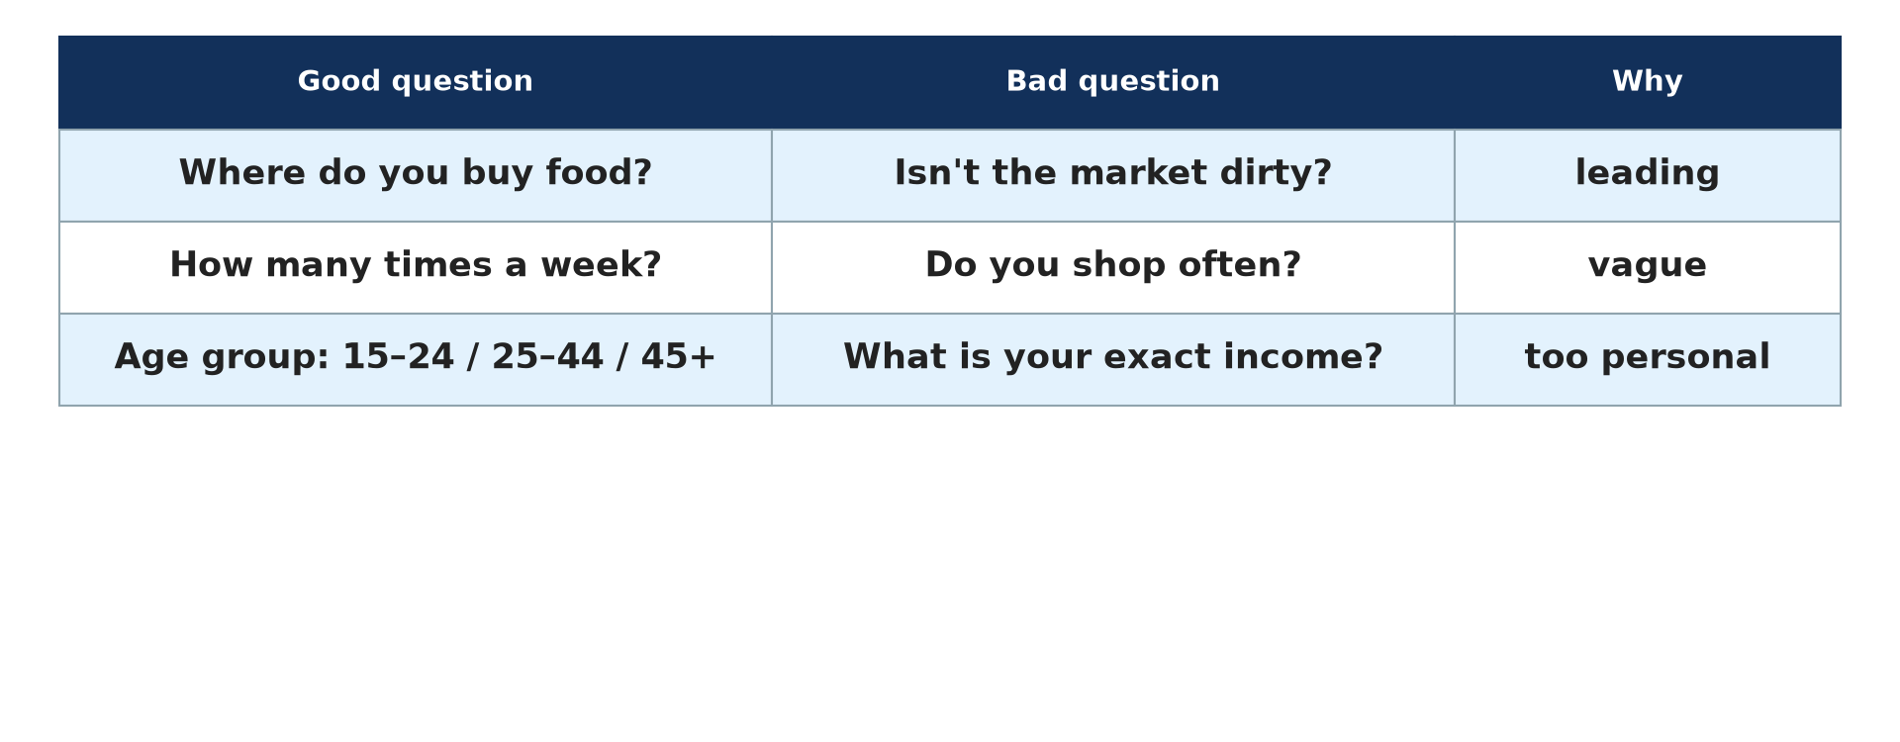
GEOGRAPHY — UPPER SIXTH ARTS
IV. QUESTIONNAIRES
Activity 5
Good and bad questions.
2026 / 2027
DGCAST GAROUA — GEOGRAPHY DEPARTMENT
Mr KAMDEM E. | 26
Notes:
Without the projector: write three questions.

Slide 27
GEOGRAPHY — UPPER SIXTH ARTS
IV. QUESTIONNAIRES
Activity 5: Question
Give two rules for a good questionnaire.
2026 / 2027
DGCAST GAROUA — GEOGRAPHY DEPARTMENT
Mr KAMDEM E. | 27

Slide 28
GEOGRAPHY — UPPER SIXTH ARTS
IV. QUESTIONNAIRES
Answer
Short, clear questions that are not leading or too personal.
2026 / 2027
DGCAST GAROUA — GEOGRAPHY DEPARTMENT
Mr KAMDEM E. | 28

Slide 29
GEOGRAPHY — UPPER SIXTH ARTS
BOARD SUMMARY
Data Collection: Sources and Techniques
Topic: Quantitative Techniques in Geography
Sub-topic: Statistical Techniques
Quantitative Techniques 2: Data Collection: Sources and Techniques
2026 / 2027
DGCAST GAROUA — GEOGRAPHY DEPARTMENT
Mr KAMDEM E. | 29
Notes:
Learners copy the board summary now. Give them enough time for each slide.

Slide 30
GEOGRAPHY — UPPER SIXTH ARTS
BOARD SUMMARY
I. Definitions
Primary data: It is data collected by the researcher in the field.
Secondary data: It is data already collected by others, like census data.
Sampling: It is the selection of a small part to represent the whole.
2026 / 2027
DGCAST GAROUA — GEOGRAPHY DEPARTMENT
Mr KAMDEM E. | 30

Slide 31
GEOGRAPHY — UPPER SIXTH ARTS
BOARD SUMMARY
II. Sources and Sampling (1/3)
A. Sources: Primary sources include observation, counts, measurements and questionnaires. Secondary sources include census, maps, reports and weather records.
B. Random sampling: Every item has an equal chance of being chosen, using random numbers. It avoids bias.
2026 / 2027
DGCAST GAROUA — GEOGRAPHY DEPARTMENT
Mr KAMDEM E. | 31

Slide 32
GEOGRAPHY — UPPER SIXTH ARTS
BOARD SUMMARY
II. Sources and Sampling (2/3)
C. Systematic and stratified: Systematic sampling chooses at regular intervals. Stratified sampling takes each group in proportion to its size.
2026 / 2027
DGCAST GAROUA — GEOGRAPHY DEPARTMENT
Mr KAMDEM E. | 32

Slide 33
GEOGRAPHY — UPPER SIXTH ARTS
BOARD SUMMARY
II. Sources and Sampling (3/3)
Copy the three methods.
2026 / 2027
DGCAST GAROUA — GEOGRAPHY DEPARTMENT
Mr KAMDEM E. | 33

Slide 34
GEOGRAPHY — UPPER SIXTH ARTS
BOARD SUMMARY
III. Techniques
A. Observation and recording: Counting, photos and videos record what is seen. Tally sheets record frequencies.
B. Questionnaires and interviews: Questionnaires use short, clear questions. Interviews and focus groups give deeper opinions.
2026 / 2027
DGCAST GAROUA — GEOGRAPHY DEPARTMENT
Mr KAMDEM E. | 34

Slide 35
GEOGRAPHY — UPPER SIXTH ARTS
FORMATIVE EVALUATION
Formative Evaluation 1
Give one advantage of each sampling method.
2026 / 2027
DGCAST GAROUA — GEOGRAPHY DEPARTMENT
Mr KAMDEM E. | 35

Slide 36
GEOGRAPHY — UPPER SIXTH ARTS
FORMATIVE EVALUATION
Expected Answer
Random: no bias. Systematic: easy. Stratified: represents all groups.
2026 / 2027
DGCAST GAROUA — GEOGRAPHY DEPARTMENT
Mr KAMDEM E. | 36

Slide 37
GEOGRAPHY — UPPER SIXTH ARTS
FORMATIVE EVALUATION
Formative Evaluation 2
Give two primary and two secondary sources.
2026 / 2027
DGCAST GAROUA — GEOGRAPHY DEPARTMENT
Mr KAMDEM E. | 37

Slide 38
GEOGRAPHY — UPPER SIXTH ARTS
FORMATIVE EVALUATION
Expected Answer
Primary: counts, questionnaires. Secondary: census, maps.
2026 / 2027
DGCAST GAROUA — GEOGRAPHY DEPARTMENT
Mr KAMDEM E. | 38

Slide 39
GEOGRAPHY — UPPER SIXTH ARTS
REMEDIATION
Remediation
Fill in the blanks:
Data you collect yourself are ______ data.
Every 10th house is ______ sampling.
A group discussion is a ______ group.
2026 / 2027
DGCAST GAROUA — GEOGRAPHY DEPARTMENT
Mr KAMDEM E. | 39
Notes:
Answers: 1. primary 2. systematic 3. focus

Slide 40
GEOGRAPHY — UPPER SIXTH ARTS
HOMEWORK
Homework
Prepare a questionnaire of five questions about how students travel to school.
This prepares Basic Tools of Data Analysis.
2026 / 2027
DGCAST GAROUA — GEOGRAPHY DEPARTMENT
Mr KAMDEM E. | 40
Notes:
This homework prepares the next lesson.

Slide 41
GEOGRAPHY — UPPER SIXTH ARTS
BILINGUAL GAME
Bilingual Game (Jeu Bilingue)
English | Français
Data | Les données
Sample | L'échantillon
Questionnaire | Le questionnaire
Interview | L'entretien
Survey | L'enquête
Census | Le recensement
2026 / 2027
DGCAST GAROUA — GEOGRAPHY DEPARTMENT
Mr KAMDEM E. | 41
Notes:
Say the English word; learners give the French word, then the reverse.

Slide 42
GEOGRAPHY — UPPER SIXTH ARTS
LOGBOOK
Official Logbook (1/2)
Module / Topic | Quantitative Techniques in Geography
Lesson Title | Quantitative Techniques 2: Data Collection: Sources and Techniques
Expected Learning Outcomes | Distinguish primary and secondary data. Describe random, systematic and stratified sampling. Design a simple questionnaire and plan an interview.
Competence | Learners are able to choose data sources, select samples and design simple questionnaires.
2026 / 2027
DGCAST GAROUA — GEOGRAPHY DEPARTMENT
Mr KAMDEM E. | 42

Slide 43
GEOGRAPHY — UPPER SIXTH ARTS
LOGBOOK
Official Logbook (2/2)
Matter Taught | I. Definitions: Primary data, Secondary data, Sampling; II. Sources and Sampling: Sources, Random sampling, Systematic and stratified; III. Techniques: Observation and recording, Questionnaires and interviews.
Evaluation | Formative evaluation (3 questions) and remediation exercise.
Homework | Prepare a questionnaire of five questions about how students travel to school.
Enrolment / Present / Absent | ____ / ____ / ____
Achievement | To be completed by the teacher after the lesson.
2026 / 2027
DGCAST GAROUA — GEOGRAPHY DEPARTMENT
Mr KAMDEM E. | 43

Slide 44
GEOGRAPHY — UPPER SIXTH ARTS
TEACHER'S NOTE
Teacher's Note
Timing: Set-up, recall 8 min | Situation 8 min | 5 activities 30 min | Board summary (copying) 30 min | Evaluation, remediation 10 min | Homework, logbook 9 min | Spare 5 min
2026 / 2027
DGCAST GAROUA — GEOGRAPHY DEPARTMENT
Mr KAMDEM E. | 44

Slide 45
GEOGRAPHY — UPPER SIXTH ARTS
REFERENCES
References
National Geography Syllabus, Sixth Forms (Lower & Upper Sixth), MINESEC/IGE/IP-SS, August 2019 — Module 8 (Practical Geography).
Photo, Activity 4: “Farmers Use Ribbon Tape Measure a Crop Field” by IFPRI, CC BY-NC-ND 2.0, via Flickr (https://www.flickr.com/photos/49258007@N03/28439241155)
Diagrams and animations: drawn for this lesson (DGCAST Geography Department).
2026 / 2027
DGCAST GAROUA — GEOGRAPHY DEPARTMENT
Mr KAMDEM E. | 45

